Slide 1

SENG 401 Group 14:
TRADR - A Campus Marketplace
By:
Nouruddine Jaffan Shaherier Khan
Hridika Banik Mary Mo
Radia Jannat Albin Radaj
Mohammed Kazmi

Slide 2

Objective/Motivation
Enhanced security through UCalgary-verified user exclusivity
Actively monitored listings and categories
Simplified communication between buyers and sellers, streamlining the buying process without sharing personal contact information
Improving student experience by facilitating marketplace transactions between verified students, alumni and faculty members on campus

Slide 3
Conducted an analysis of leading online marketplaces, such as Kijiji and Facebook Marketplace, to identify common and essential features and functionalities
Identifying the needs, preferences, and expectations of potential users of Tradr through a user-centric approach
Created use case diagrams and prioritised requirements according to their importance and feasibility
Requirements Elicitation

Slide 4
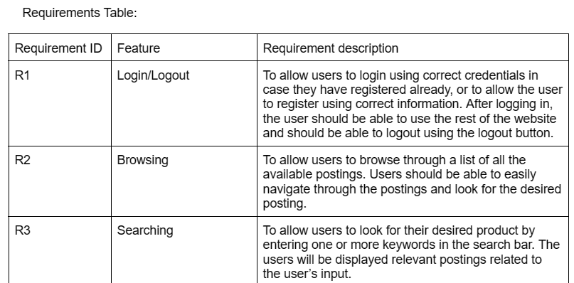
Requirements

Slide 5
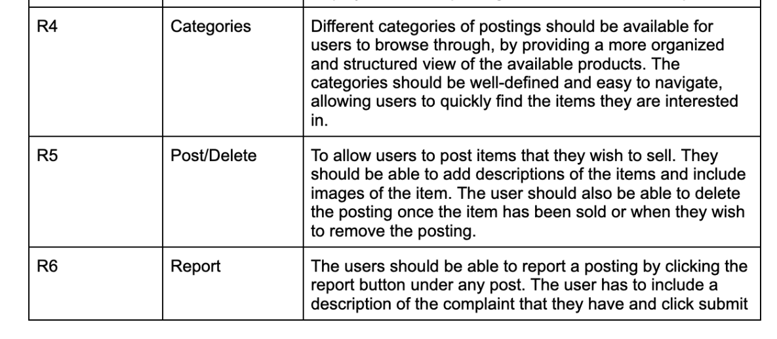
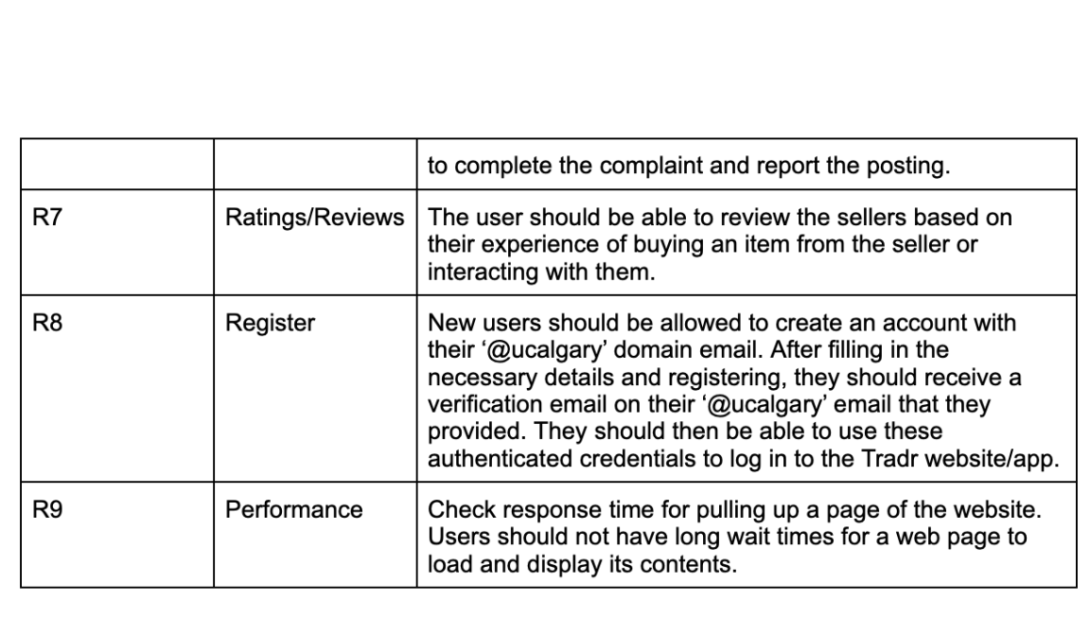
Requirements

Slide 6
Requirements

Slide 7
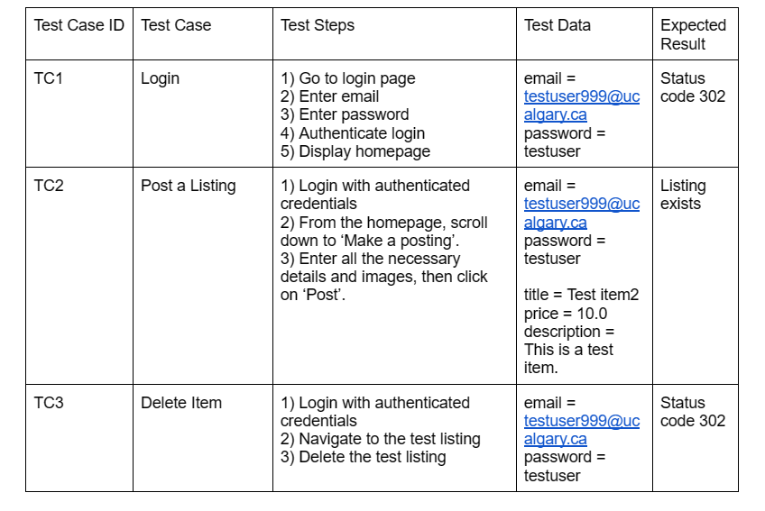
Test Cases

Slide 8
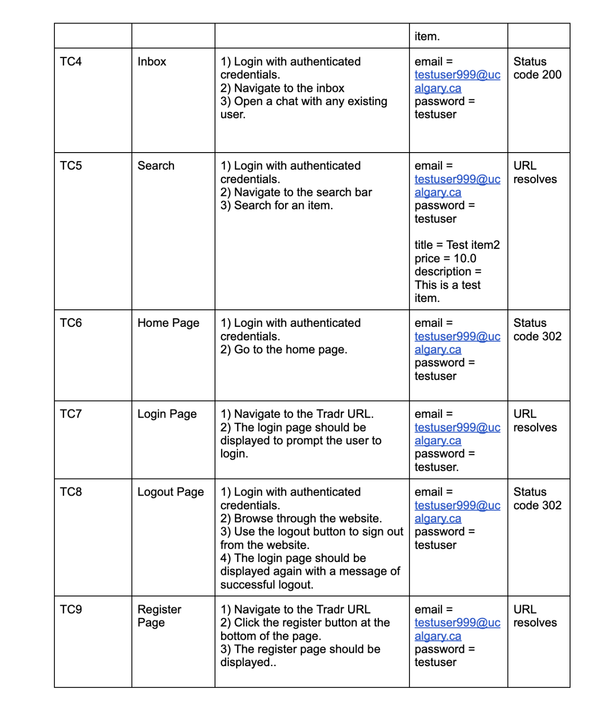
Test Cases

Slide 9
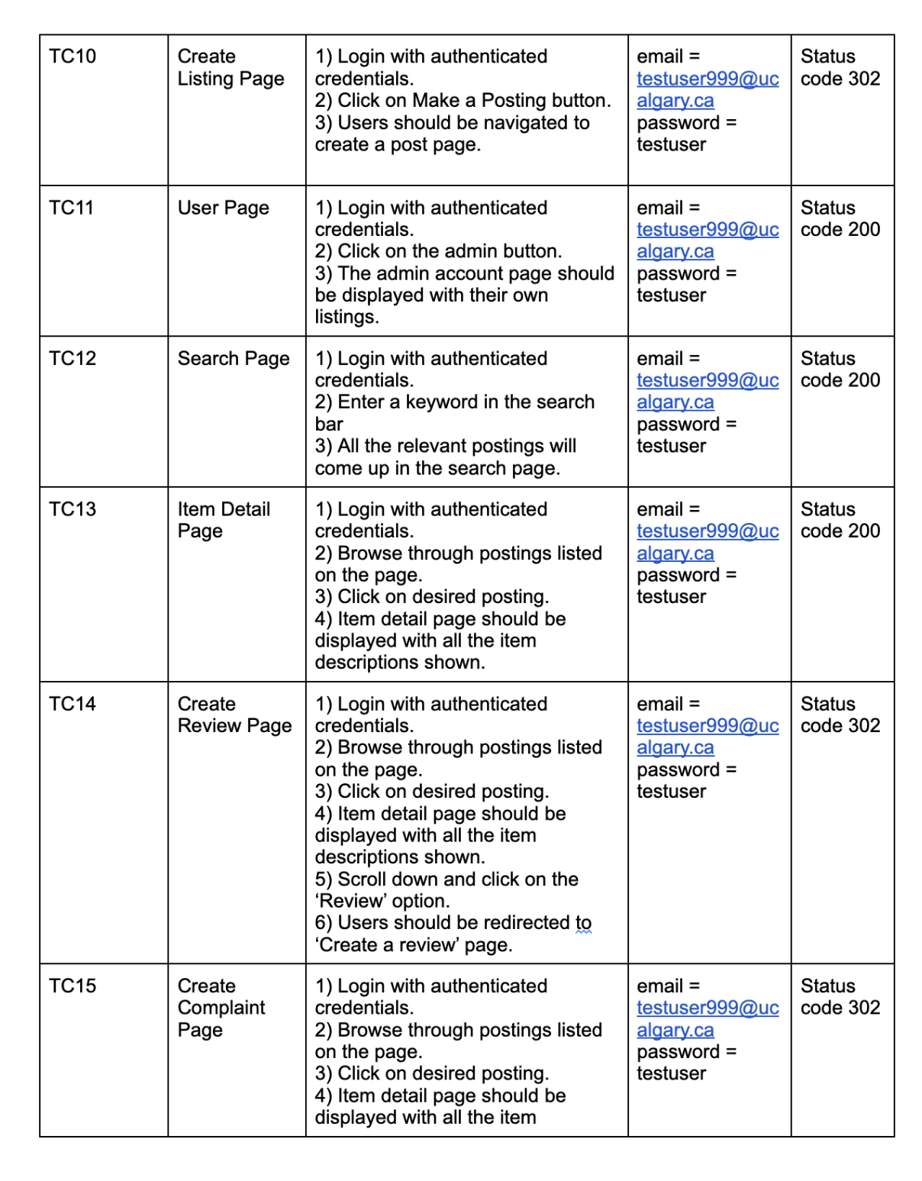
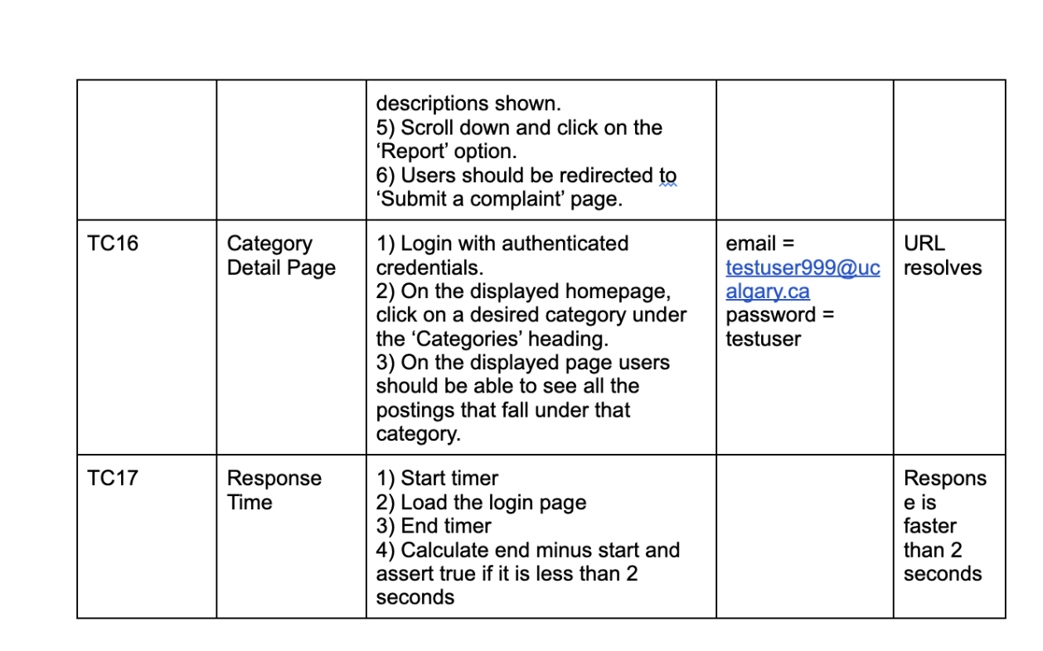
Test Cases

Slide 10
Test Cases

Slide 11
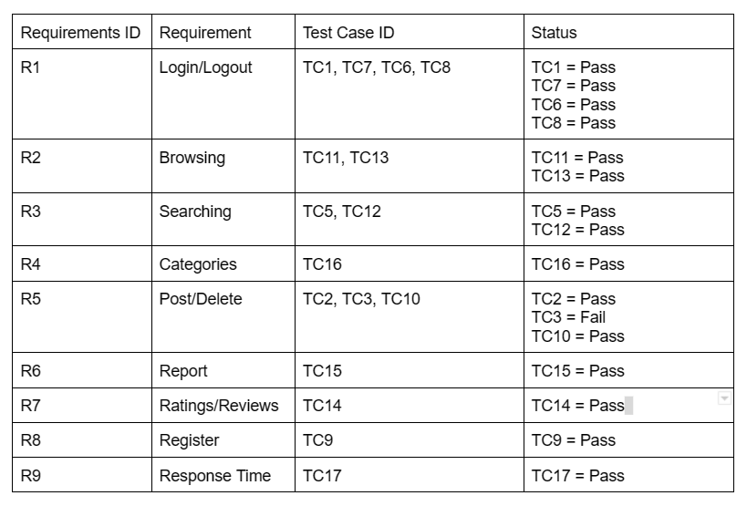
RTM
Notes:
And based on those requirements and test cases tables, we’ve created this requirement traceability matrix and as you can see, the test results are captured on the right-most column

Slide 12
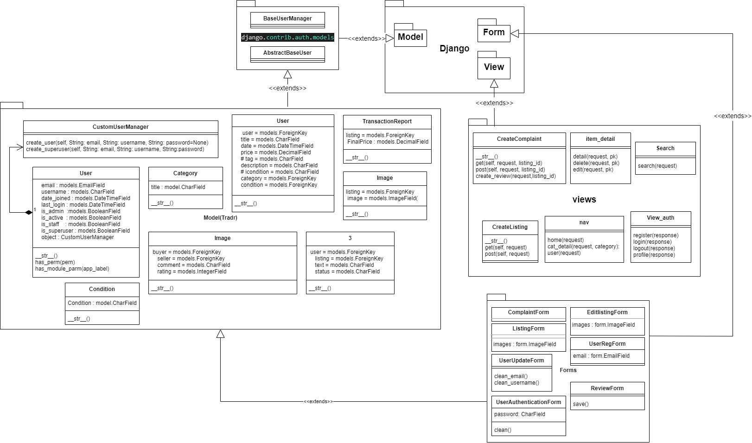
Class Diagram
Listing

Slide 13
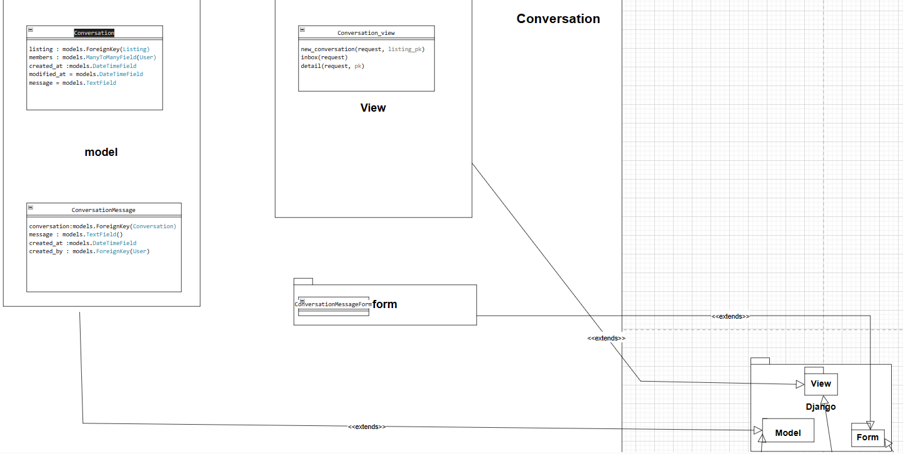
Class Diagram pt2

Slide 14
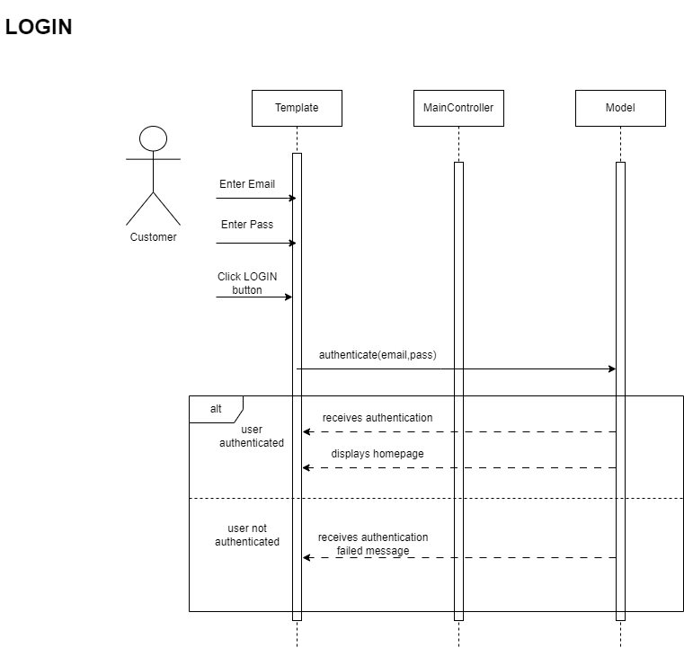
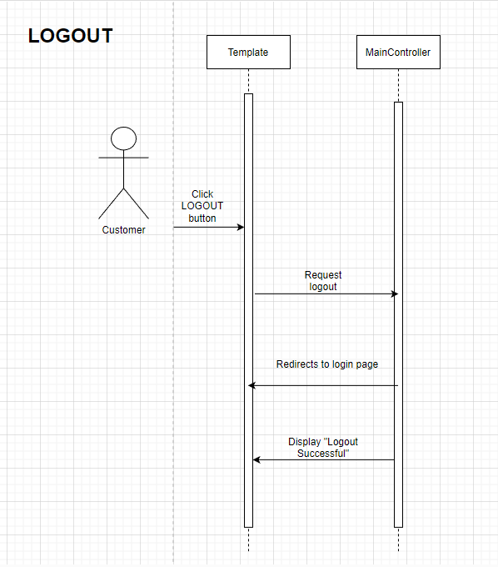
Sequence Diagrams
Notes:
Here are sequence diagrams for important features, here we have login and logout, these helped illustrate the flow of data and interaction between different components of the program.
Login

Slide 15
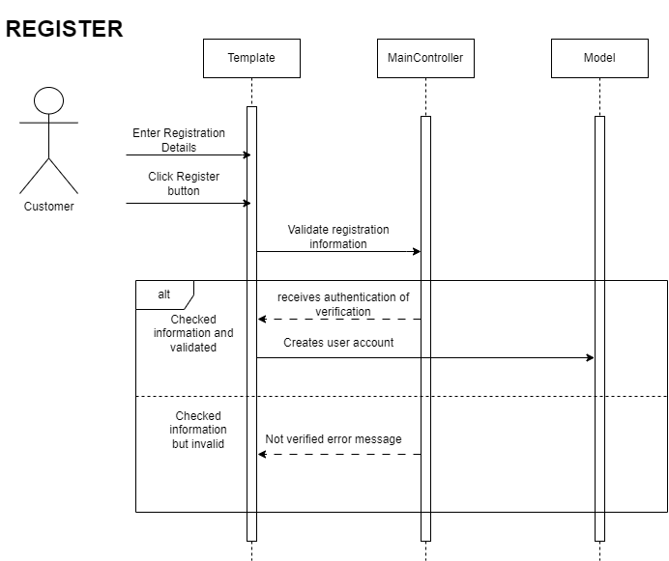
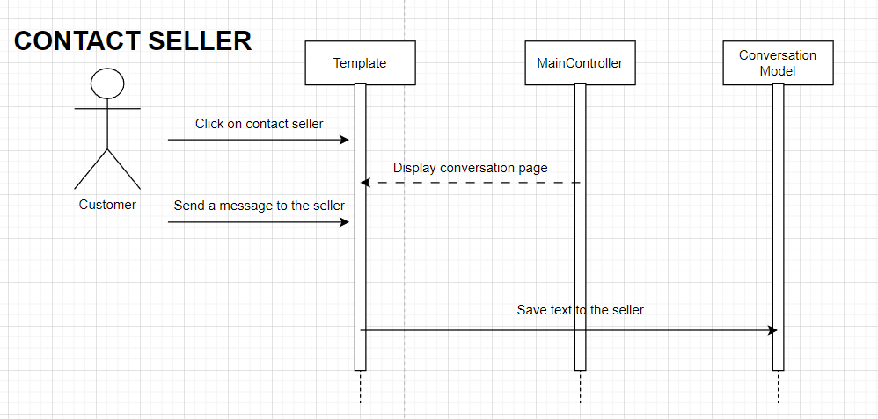
Sequence Diagrams

Slide 16
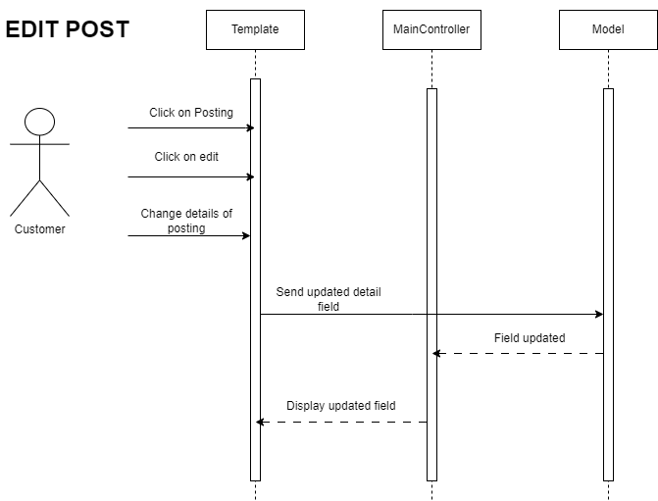
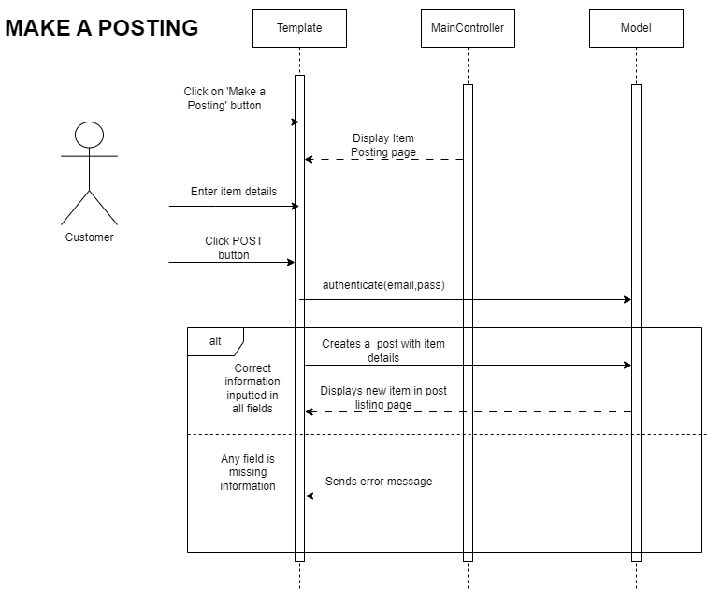
Sequence Diagrams

Slide 17
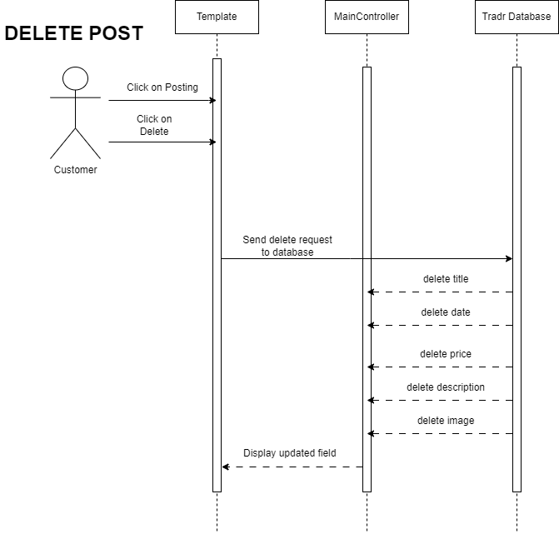
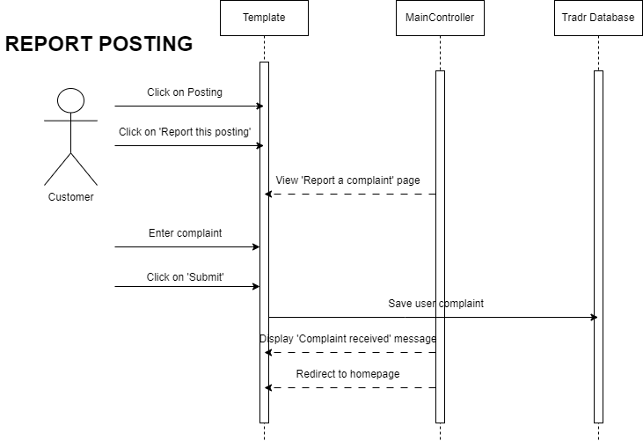
Sequence Diagrams

Slide 18
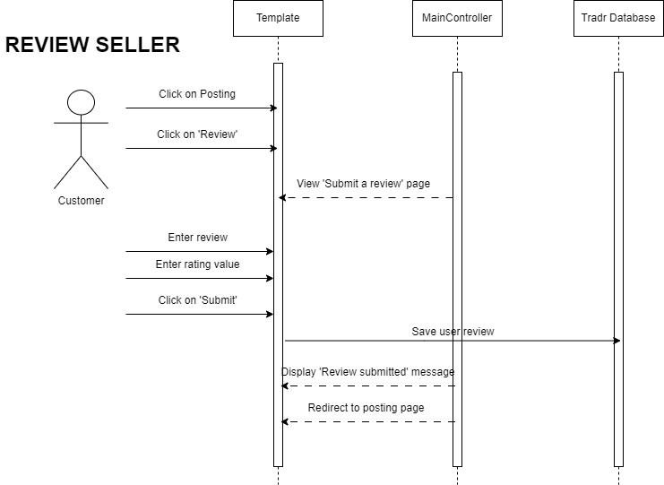
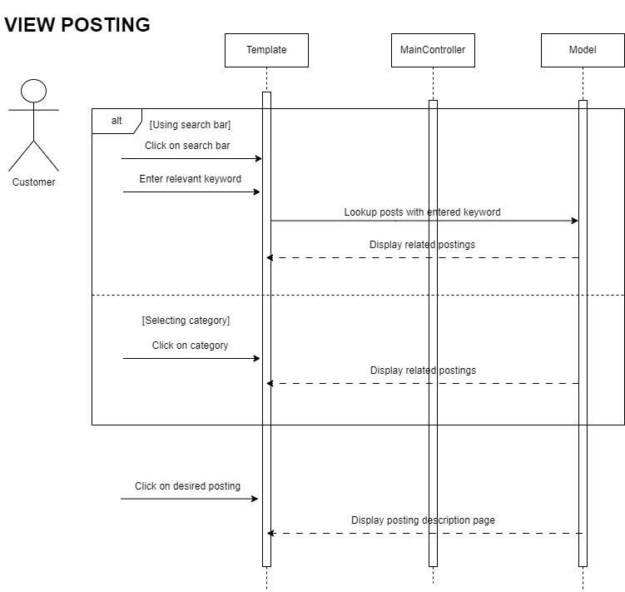
Sequence Diagrams

Slide 19
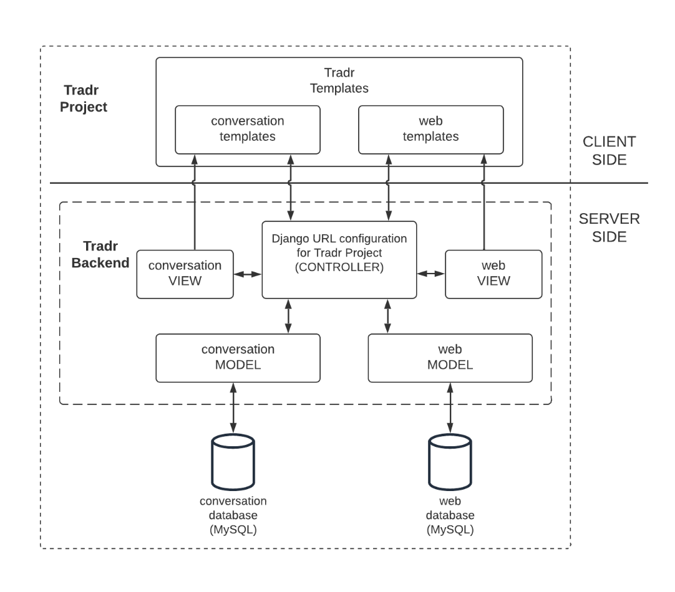
Architecture
MVC
MVT (Django)
Microservices
Notes:
Mary
Our app has a combination of MVC, MVT and Microservices.
Our original architecture plan was to combine MVC and Microservices. We chose MVC to separate the app into the three components for better reusability of codes and flexibility, and microservices was our choice as we believed it would allow multiple people to work on different functionalities simultaneously as we develop the app in a short period of time. However, we ended up choosing Django framework to build our app, which utilizes Model View Template architecture, and this is because the role of controller is handled internally by the framework. So this diagram is the design we came up with to capture all three patterns. Since the django url configuration acts like a controller, navigating the user input to the correct backend methods in the view components, I analyzed the Django url config to be acting as a controller. So the MVC pattern is here, MVT pattern is captured here, with the templates handling the rendering and html files, and lastly our microservices pattern is captured here as we created two different django apps for different functionalities

Slide 20

We’ll help bring your life experiences to campus!
Notes:
Here are some screenshots of our product’s frontend
This is the homepage where the most recent listings are shown in the middle and the navigation bar is on the left, with a search bar on the top

Slide 21
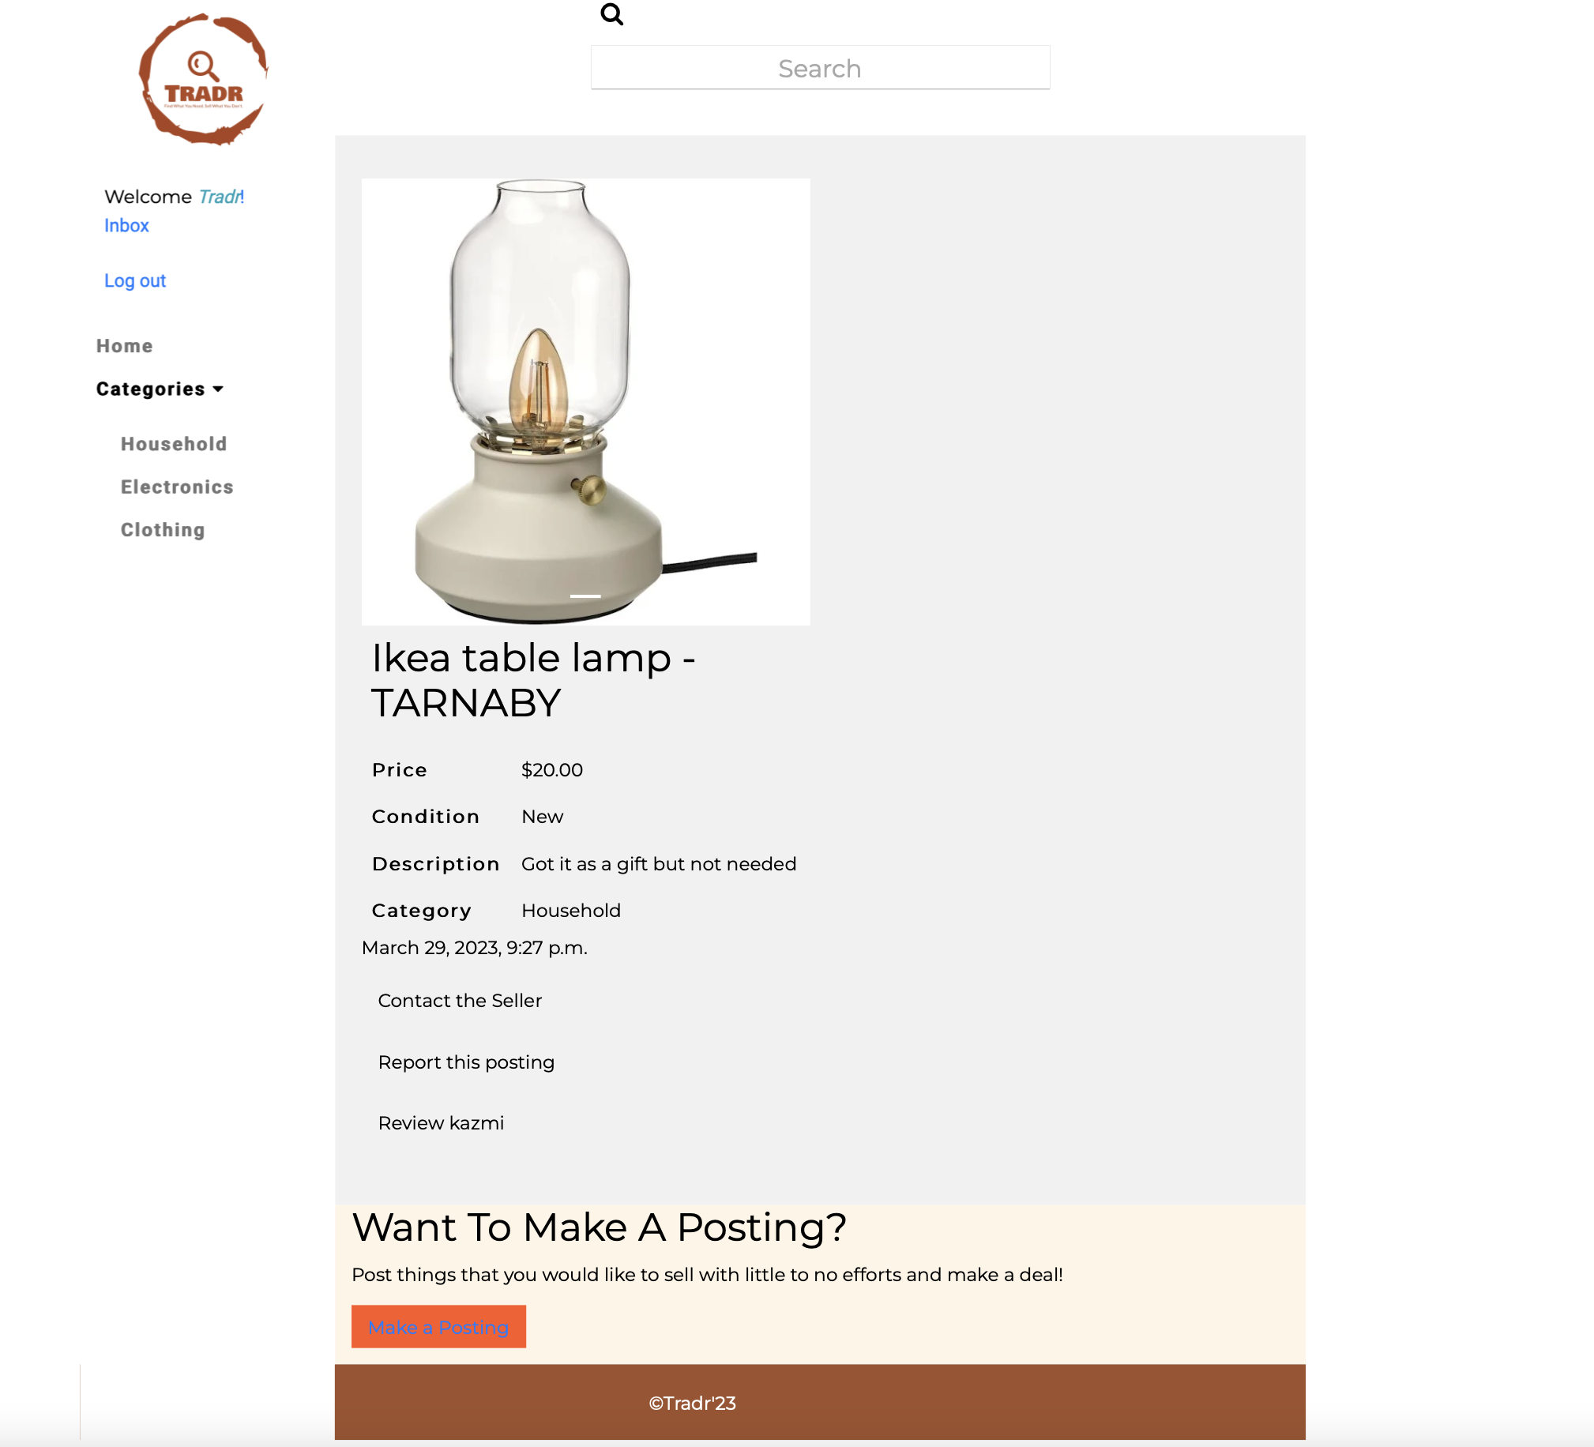
Notes:
Here is an example of a posting, and it has the features such as contact or review the seller or report the posting

Slide 22
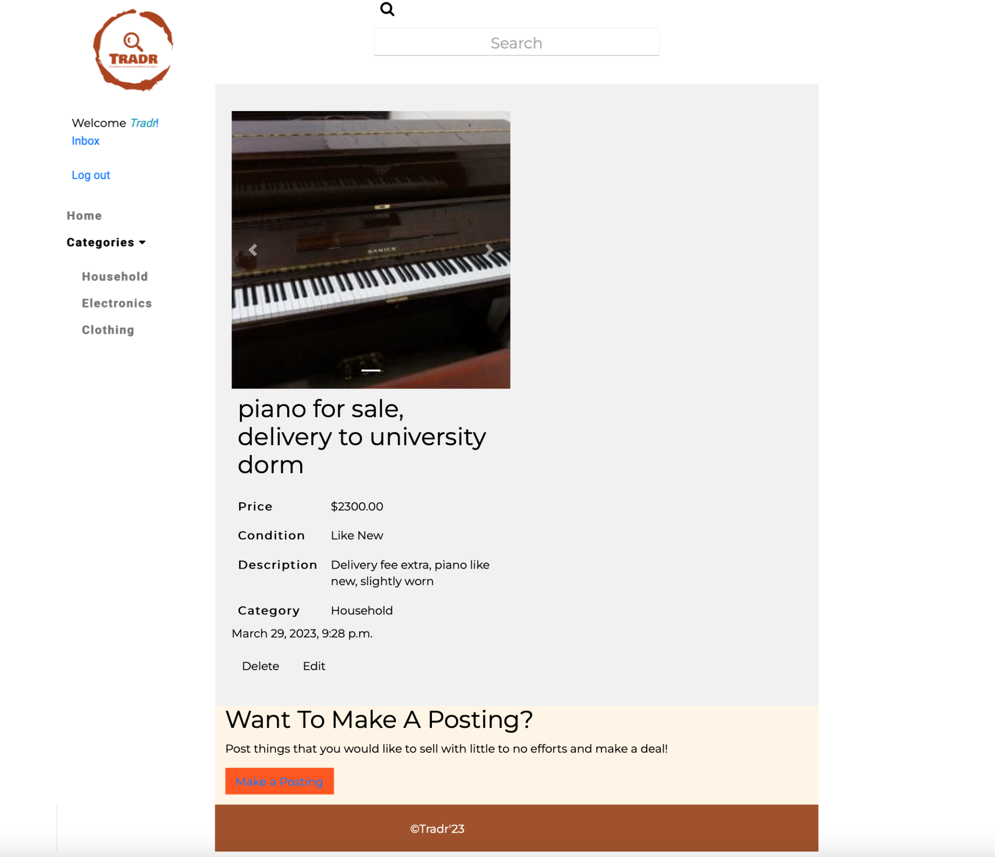
Notes:
If it’s a posting you created, you can delete and edit

Slide 23
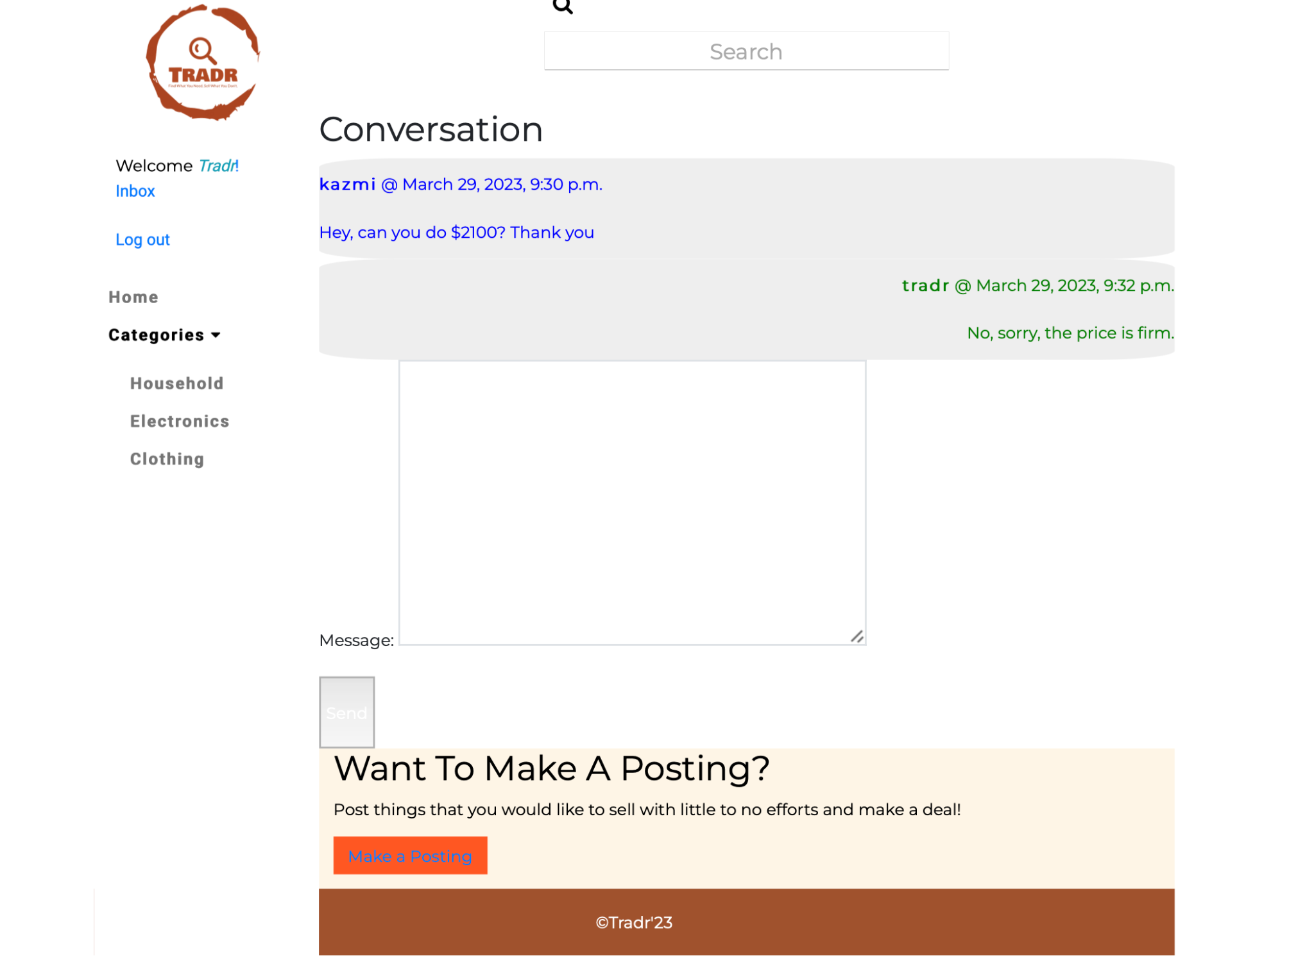
Notes:
And here is an example of chat system between the users

Slide 24
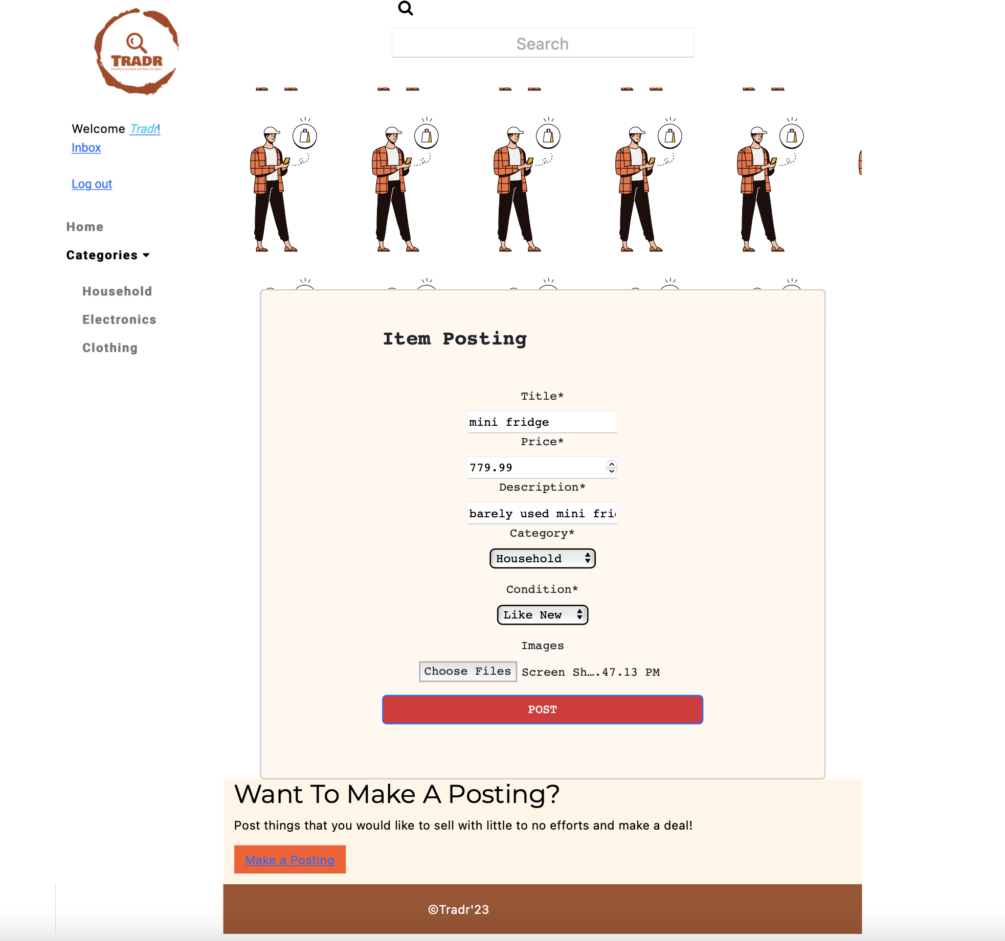
Notes:
Add posting page where there’s drop down menus for category and conditions, which are preset and can only be edited by admin

Slide 25
Retrospective/next steps
More microservices possible
Bring more community-based features to the platform
Make the review method more sophisticated - confirm transaction before reviewing
Improve user experience
Be able to select specific images to delete on multi-image posts
Error checking on registration page
Password reset
Notes:
Separating user authentication and posting functions
More community based features like campus apps, more campus features, can be customized for different colleges as well
otehr

Slide 26
Questions?

